Slide 1
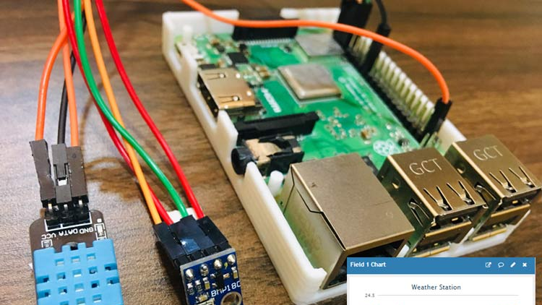
Raspberry Pi Weather Station
Omar Fadel 1002097
Ahmed Khaled 1002701
Mariam Magdy 1000659
Farida Helaly 1000960
Omar Yasser 1002195
Ahmed ElAraby 1002199

Slide 2

Introduction/Recap
This is an IoT based project with the purpose of sending weather conditions data from a RPI 4 board and other sensors to ThingSpeak.
According to Dr Ansgar’s recommendation we avoided using any BME/BMP sensors due to their complexity thus they were replaced with a humble Rain detection sensor.
In summary, the sensors used were the DHT22 (Temperature & Humidity) & FC-37 (Rain detection).

Slide 3
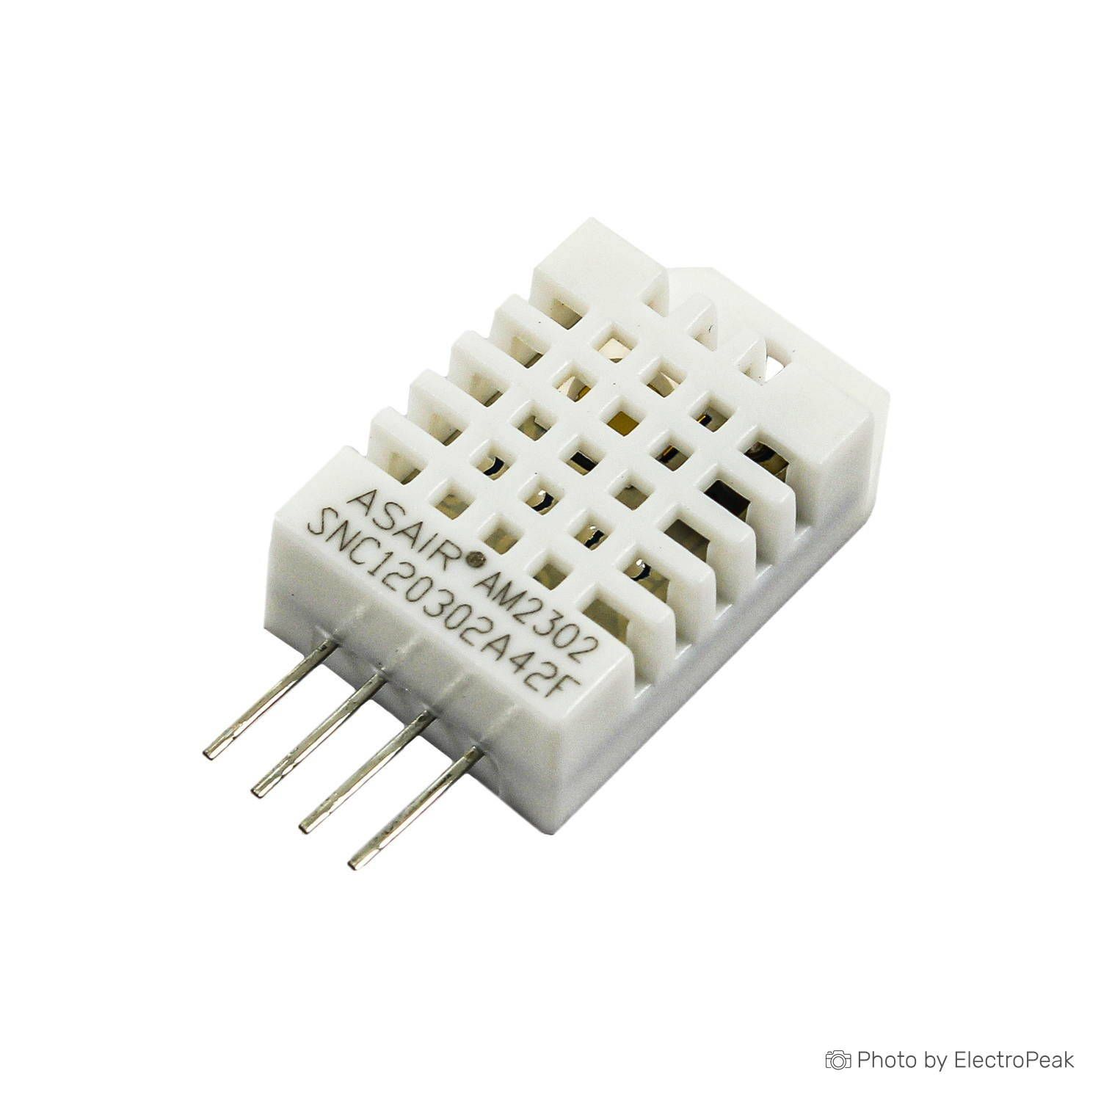
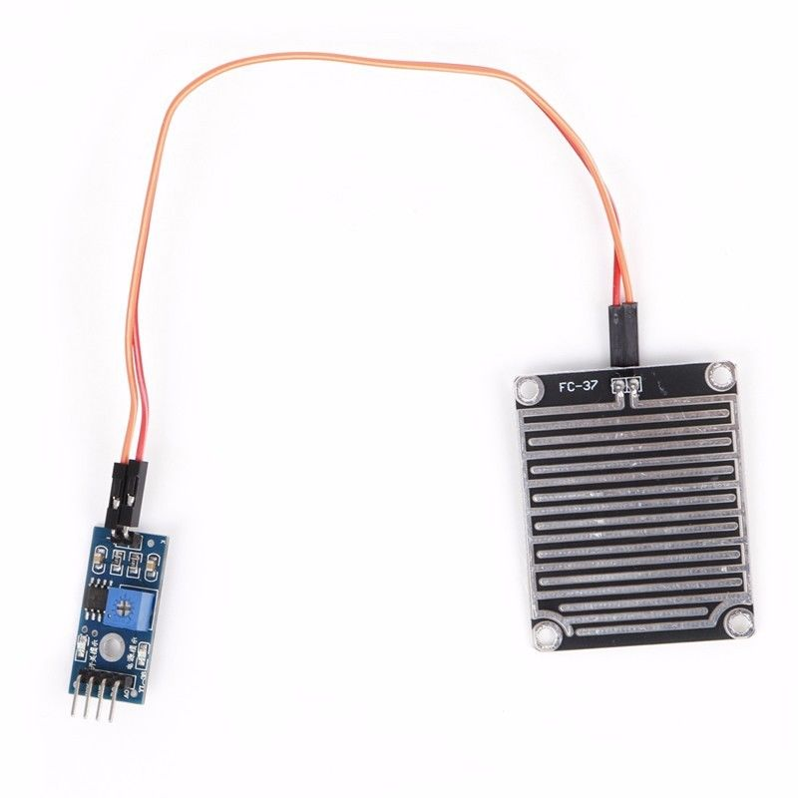
SENSORS
DHT22
FC-37

Slide 4
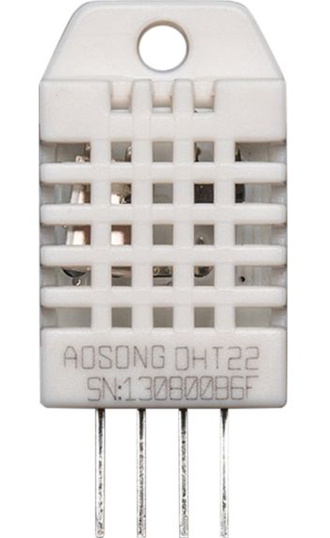
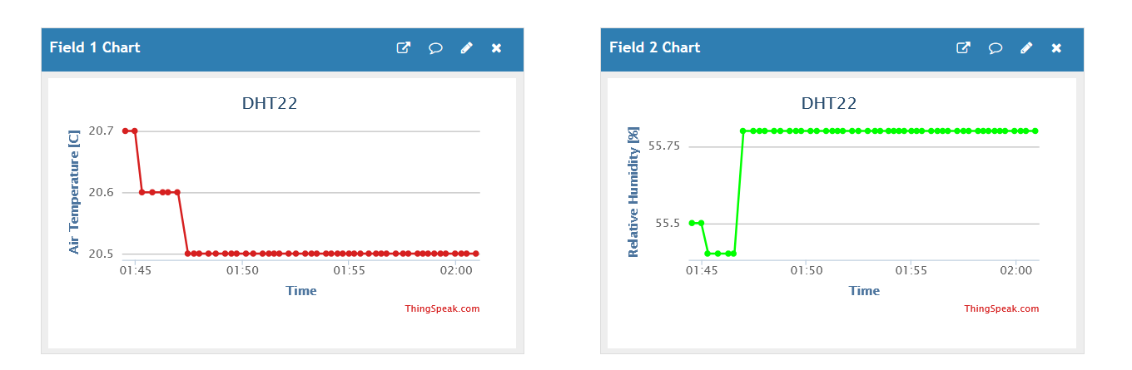
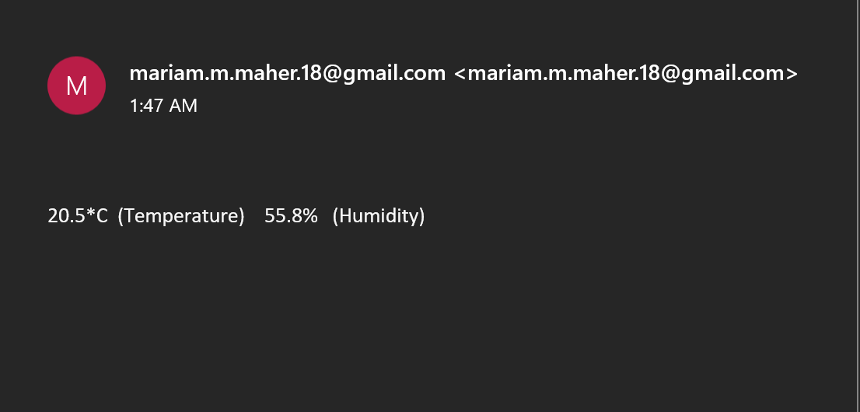
DHT22
The DHT22 is a basic, low-cost digital temperature and humidity sensor.
It measures the temperature in °C and the humidity in the air in percentage

Slide 5
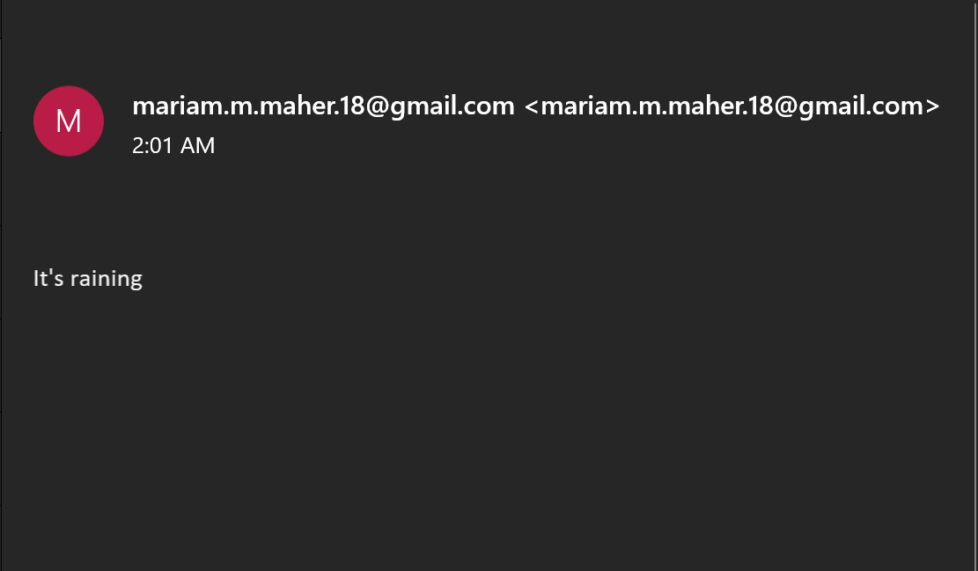
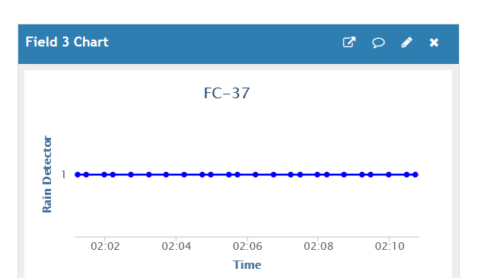
FC-37
The rain sensor is used to detect water and it can detect beyond of what a humidity sensor do.
The data gathered from this sensor is “Binary” which gives out two results→ Either if it’s raining or not.

Slide 6


Thonny Python IDE
Thonny IDE is a built in IDE that comes with the Raspberry Pi, which is simple to use.
Python 3 was the coding language used for this project.

Slide 7
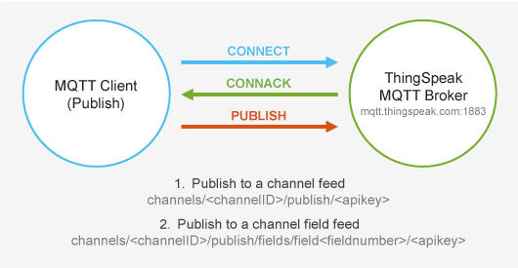
Protocols used:
MQTT: The ThingSpeak IoT platform enables clients to update and receive updates from channel feeds via the ThingSpeak MQTT broker. MQTT is a publish/subscribe communication protocol that uses TCP/IP sockets or WebSockets. MQTT over WebSockets can be secured with SSL. A client device connects to the MQTT broker and can publish to a channel or subscribe to updates from that channel.

Slide 8
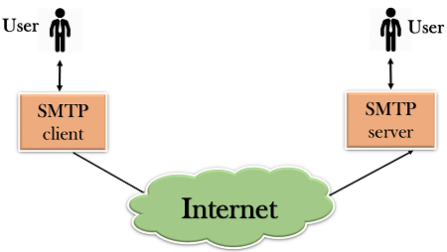
Protocols used:
SMTP: SMTP stands for Simple Mail Transfer Protocol which uses TCP connection, and it’s an application used by mail servers to send, receive, and/or relay outgoing mail between email senders and receivers.

Slide 9

Visualization of data
Data is visualized using both protocols MQTT & SMTP.
ThingSpeak:It is an open-source Internet of Things (IoT) application to store and retrieve data from things, using MQTT APIs.
Email: When you send an email, with SMTP host Gmail or AOL, the SMTP server processes your email, decides which server to send the message to, and relays the message to that server.

Slide 10
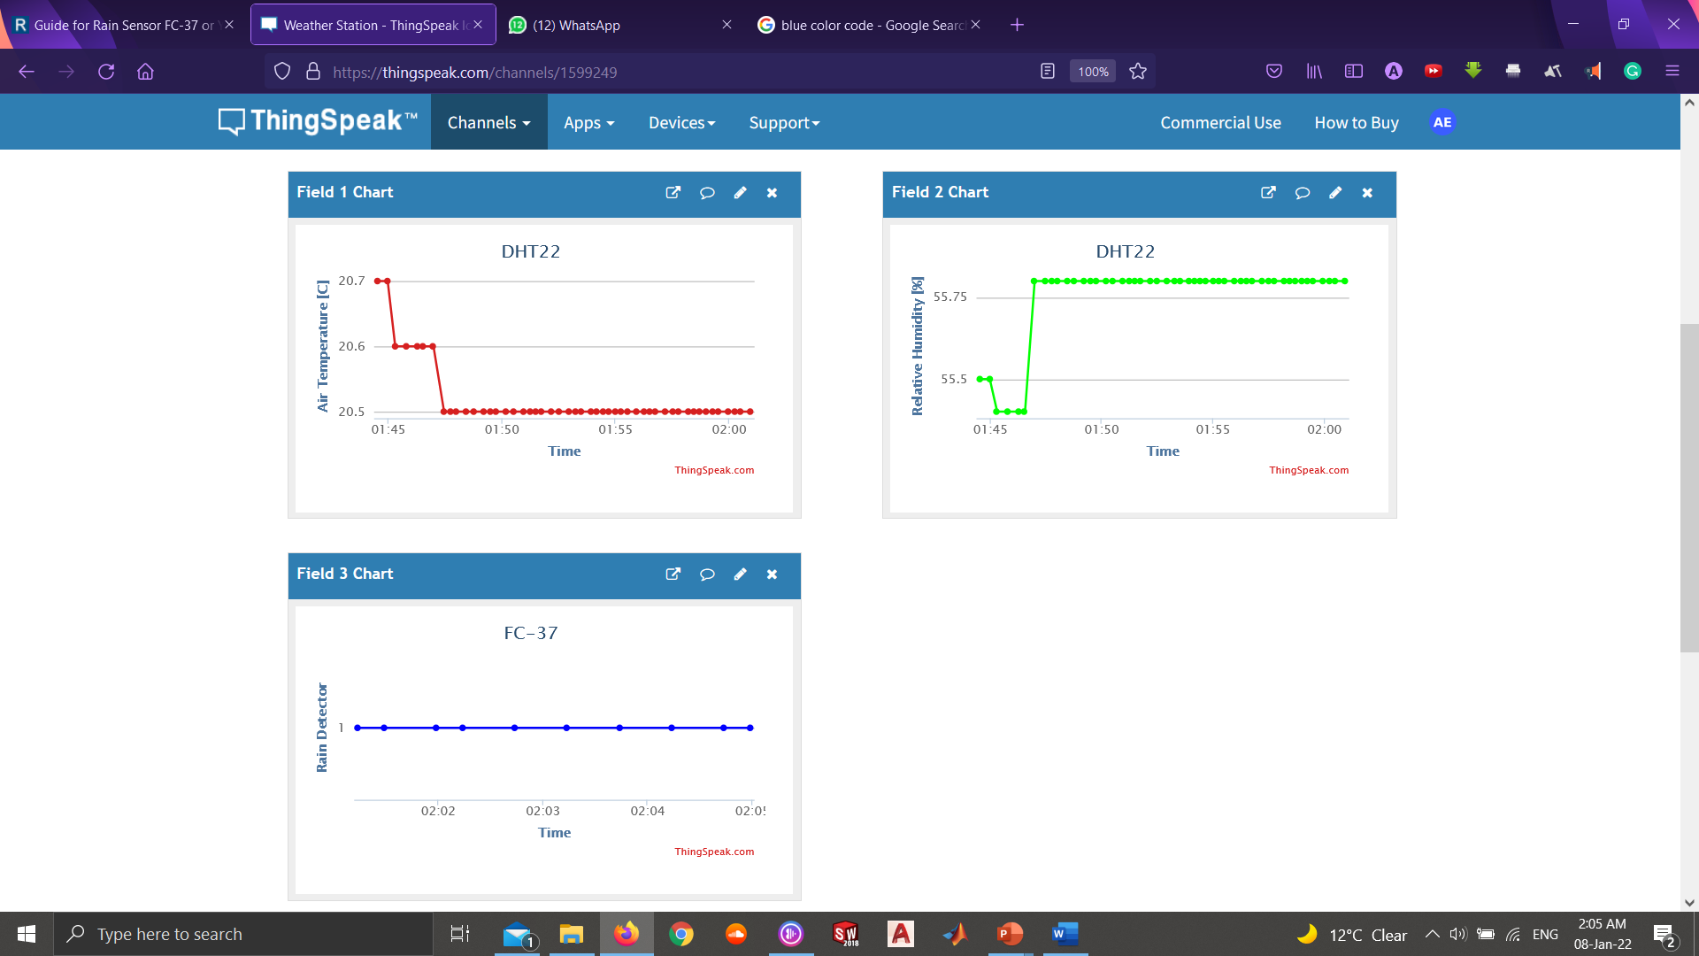
ThingSpeak
Channel ID: 1599249
Link: https://thingspeak.com/channels/1599249

Slide 11
Mail

Slide 12

Thank you
Any questions?

